Slide 1
MGMT 58600: Python Programming
Lecture 5
Dr. Shoaib Khan

Slide 2
Add Elements to a List
Using append(): the method adds an item at the end of the list. E.g.,
numbers = [21, 34, 54, 12]
print("Before Append:", numbers)
# using append method
numbers.append(32)
print("After Append:", numbers)
Using extend(): the method adds all the items of an iterable (list, tuple, string, dictionary, etc.) to the end of the list. E.g.,
numbers = [1, 3, 5]
even_numbers = [4, 6, 8]
# add elements of even_numbers to the numbers list
numbers.extend(even_numbers)
print("List after append:", numbers)

Slide 3
Add Elements to a List
Using insert(): this method adds an element at a specified index. E.g.,
numbers = [10, 30, 40]
# insert an element at index 1 (second position)
numbers.insert(1, 20)
print(numbers) # [10, 20, 30, 40]

Slide 4
Changing List Items
Python lists are mutable (can be modified). We can change items of a list by assigning new values using the = operator. E.g.,
languages = ['Python', 'Swift', 'C++']
# changing the third item to 'C'
languages[2] = 'C'
print(languages) # ['Python', 'Swift', 'C']

Slide 5
Remove Items From a List
Using del statement: removes one or more items from a list. E.g.,
languages = ['Python', 'Swift', 'C++', 'C', 'Java', 'Rust', 'R']
# deleting the second item
del languages[1]
print(languages) # ['Python', 'C++', 'C', 'Java', 'Rust', 'R']
# deleting the last item
del languages[-1]
print(languages) # ['Python', 'C++', 'C', 'Java', 'Rust']
# delete the first two items
del languages[0 : 2] # ['C', 'Java', 'Rust']
print(languages)

Slide 6
Remove Items From a List
We can also use the remove() method to delete a list item. For example,
languages = ['Python', 'Swift', 'C++', 'C', 'Java', 'Rust', 'R']
# remove 'Python' from the list
languages.remove('Python')
print(languages) # ['Swift', 'C++', 'C', 'Java', 'Rust', 'R']

Slide 7
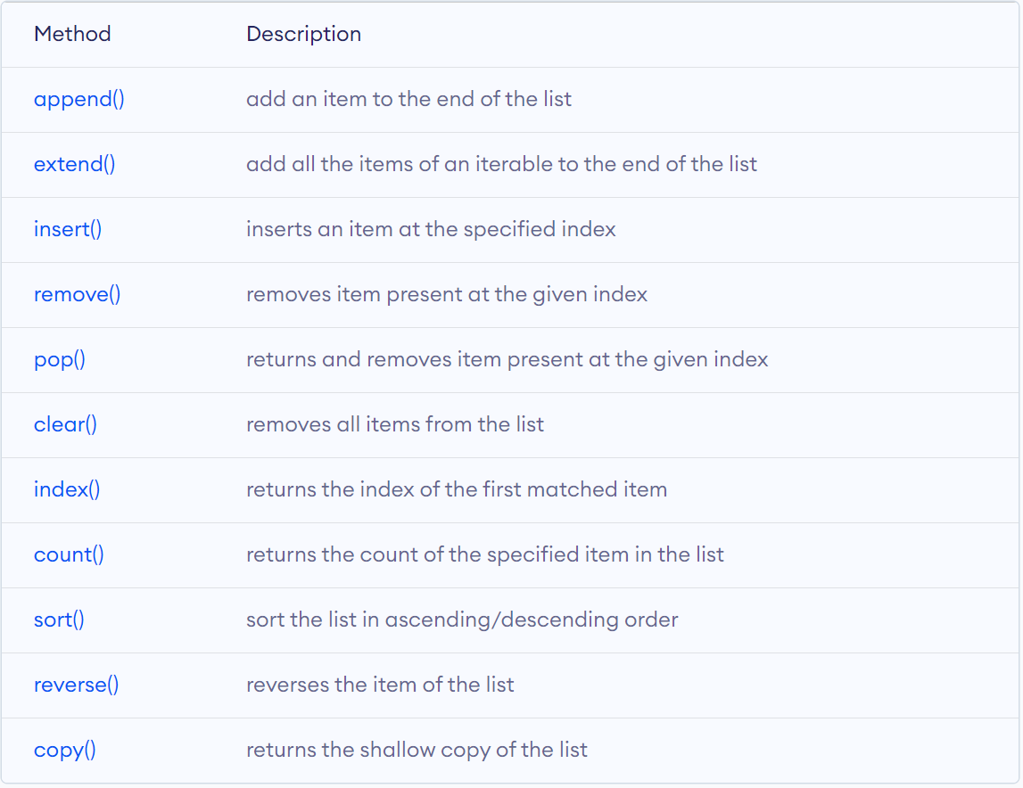
List Methods
Python has many useful list methods that makes it really easy to work with lists.

Slide 8
Sorting a List
sort() method is used to sort the elements of a list in ascending order by default. E.g.,
unsorted_list = [2,4,5,32,6,255,5,42]
unsorted_list.sort()
print("Now it is sorted:", unsorted_list)
To sort a list in descending order, set the reverse parameter to True of the sort() method. E.g.,
# List of Integers
numbers = [1, 3, 4, 2]
# Sorting list of Integers
numbers.sort(reverse=True)
print(numbers) # List of Floating point numbers
decimalnumber = [2.01, 2.00, 3.67, 3.28, 1.68]
# Sorting list of Floating point numbers
decimalnumber.sort(reverse=True)
print(decimalnumber)
# List of strings
words = [“programming", “is", “fun"]
# Sorting list of strings
words.sort(reverse=True)
print(words)

Slide 9
Working With Lists
Iteration: We can use a for loop to iterate over the elements of a list. For example,
languages = ['Python', 'Swift', 'C++']
# iterating through the list
for language in languages:
print(language)
Check if an Element Exists in a List: We use the ‘in’ keyword to check if an item exists in the list or not. For example,
languages = ['Python', 'Swift', 'C++']
print('C' in languages) # False
print('Python' in languages) # True

Slide 10
List Comprehension
List comprehension is a concise and elegant way to create lists. For example,
# create a list with value n ** 2 where n is a number from 1 to 5
numbers = [n**2 for n in range(1, 6)]
print(numbers)

Slide 11
Review: Dictionaries
Python dictionary is a collection of items where each item is a key-value pair.
For example, you can represent a student as a dictionary:
student = {
"name": "Alice",
"graduated": False,
"CGPA": 3.49,
"age": 22,
"hobbies": ["Jogging", "Gym", "Boxing"]
}
This dictionary has five elements (key-value pairs), where objects in red are keys and objects in blue are corresponding values.

Slide 12
Access Items
We can access the value of a dictionary item by placing the key inside square brackets. E.g.,
print(student[‘name’])
print(student[‘CGPA’])
We can also use the get() method to access the value of a dictionary item.
print(student.get(‘name’))
print(student.get(‘CGPA’))
get() method takes maximum of two parameters:
key - key to be searched in the dictionary
value (optional) - Value to be returned if the key is not found. The default value is None
get() method returns:
the value for the specified key if key is in the dictionary.
None if the key is not found and value is not specified.
value if the key is not found and value is specified.

Slide 13
Access Items
Python get() method Vs dict[key] to Access Elements:
get() method returns a default value if the key is missing.
dict[key] raises KeyError exception if the key is missing.
We can also use the setdefault() method to access the value of a dictionary item. (more on this in the following slide)

Slide 14
Add Items
We can add an item to a dictionary by assigning a value to a new key. For example,
student[‘email’] = ‘alice@purdue.edu’
We can add an item to a dictionary using setdefault() method
setdefault() method takes maximum of two parameters:
key – key to be searched in the dictionary.
default_value (optional) – key with default_value is inserted in the dictionary if key is not in the dictionary. If not specified, the default_value will be None.
setdefault() returns the value of a key (if the key is in the dictionary). Else, it inserts a key with the default_value to the dictionary
student.setdefault(‘status’, 1)

Slide 15
Modify Items
Python dictionaries are mutable (changeable). We can change the value of a dictionary element by referring to its key. For example,
student[‘CGPA’]= 3.5

Slide 16
Remove Items
We can use the del statement to remove an element from a dictionary. For example,
del student[‘email’]
If we need to remove all items from a dictionary at once, we can use the clear() method.

Slide 17
Membership Test
We can check whether a key exists in a dictionary by using the in and not in operators.
print(‘age’ in student)
print(‘gender’ in student)
print(‘height’ not in student)
The in operator checks whether a key exists; it doesn't check whether a value exists or not.

Slide 18
Iterate Through a Dictionary
We can iterate through dictionary keys one by one using a for loop.
for attribute in student:
print(attribute)
There are three dictionary methods that will return list-like values of the dictionary’s keys, values, or both keys and values: keys(), values(), and items()
The values returned by these methods are not true lists: they cannot be modified
But these data types (dict_keys, dict_values, and dict_items, respectively) can be used in for loops.

Slide 19
Iterate Through a Dictionary
Iterating over keys using keys() method:
for key in student.keys():
print(key)
Iterating over values using values() method:
for val in student.values():
print(val)
Iterating over items using items() method:
for entry in student.items():
print(entry)
Iterating over key, value pairs using items() method:
for k, v in student.items():
print(f‘key = {k}, value = {v}’)

Slide 20
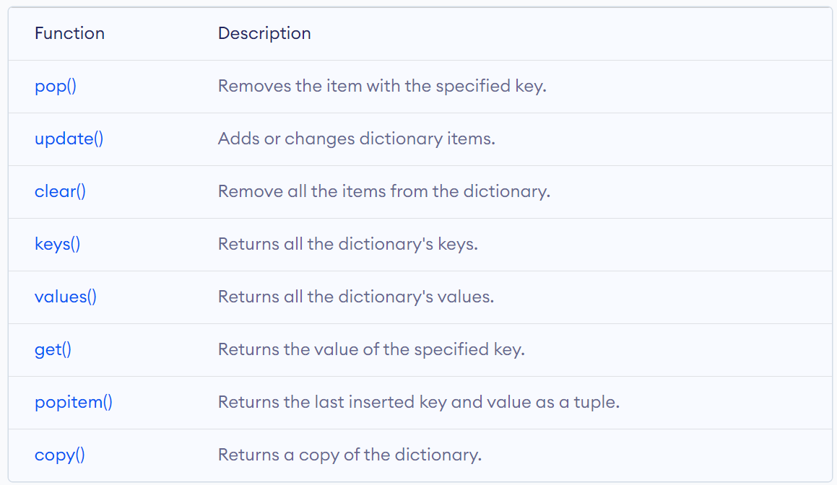
Python Dictionary Methods
Here’s a list of some commonly used dictionary methods in python:

Slide 21
Sorted() Function
The sorted() function returns the sorted elements of a given iterable in ascending order.
>>> numbers = [5, 3, 4, 3, 6, 7, 2, 1]
>>> sorted(numbers)
[1, 2, 3, 3, 4, 5, 6, 7]
Along with the iterable, the sorted() method also has two optional keyword arguments: key and reverse
key - function that determines the basis for sort comparison. Default value - None
reverse - boolean that decides the sorting order. If True, the list is sorted in descending order

Slide 22
Sorted() Function
To sort in descending order, we set reverse = True:
>>> numbers = [5, 3, 4, 3, 6, 7, 2, 1]
>>> sorted(numbers, reverse = True)
[7, 6, 5, 4, 3, 3, 2, 1]
To sort with some key function, we can set the key argument to the name of the function used to determine the basis for sorting:
fruits = ['apple', 'banana', 'kiwi', 'pomegranate']
# sort the list based on the length of each string
sorted_fruits = sorted(fruits, key=len)
print('Sorted list:', sorted_fruits)
# Output: Sorted list: ['kiwi', 'apple', 'banana', 'pomegranate']

Slide 23
Sorting Dictionaries
We can sort dictionaries using the sorted() function.
people = {3: "Jim", 2: "Jack", 4: "Jane", 1: "Jill"}
# Sort by key
dict(sorted(people.items()))
#output: {1: 'Jill', 2: 'Jack', 3: 'Jim', 4: 'Jane’}
# Sort by value with a user defined function
def get_value(item):
return item[1]
sorted(people.items(), key=get_value)
#output:[(2, 'Jack'), (4, 'Jane'), (1, 'Jill'), (3, 'Jim')]

Slide 24
Python Lambda Functions
A lambda function is a special type of function without the function name (anonymous functions).
We use the lambda keyword instead of def to create a lambda function. E.g.,
lambda argument(s) : expression
argument(s) - any value(s) passed to the lambda function
expression - expression is executed and returned
Sorting a dictionary using a lambda function:
sorted(people.items(), key=lambda item: item[1])
#output:[(2, 'Jack'), (4, 'Jane'), (1, 'Jill'), (3, 'Jim')]

